Slide 1

Chapter 2.4
Some Important Distributions
Performance Evaluation of the Internet of Things (IoT)
Module Course: Performance Evaluation of Distributed Systems
Prof. Tobias Hoßfeld, Summer Semester 2022

Slide 2

Disclaimer and Copyright Notice
Lecture slides, figures, and scripts are based on the open access text book “Performance Modeling and Analysis of Communication Networks”. The book and scripts are licensed under the Creative Commons License Attribution-ShareAlike 4.0 International (CC BY-SA 4.0). If you remix, transform, or build upon the material, you must distribute your contributions under the same license as the original.
The book must be cited and the disclaimer attached when using lectures slides or scripts.
Tran-Gia, P. & Hossfeld, T. (2021). Performance Modeling and Analysis of Communication Networks - A Lecture Note. Würzburg University Press. https://doi.org/10.25972/WUP-978-3-95826-153-2
Website to download book, exercises, slides and scripts: https://modeling.systems/

Slide 3
Chapter 2
2 Fundamentals and Prerequisites
2.1 Little’s Theorem and General Results
2.1.1 Little’s Law in Finite Systems with Blocking
2.1.2 Example: Multiclass Systems
2.1.3 Example: Balking
2.1.4 The Utilization Law
2.1.5 Assumptions and Limits of Little’s Law
2.1.6 General Results for GI/GI/n Delay Systems
2.1.7 Loss Formula for GI/GI/n-S Loss Systems
2.2 Probabilities and Random Variables
2.2.1 Random Experiments and Probabilities
2.2.2 Other Terms and Properties
2.2.3 Random Variable, Distribution, Distribution Function
2.2.4 Expected Value and Moments
2.2.5 Functions of Random Variables and Inequalities
2.2.6 Functions of Two Random Variables
2.3 Transform Methods
2.3.1 Generating Function
2.3.2 Laplace and Laplace-Stieltjes Transforms
2.4 Some Important Distributions
2.4.1 Discrete Distributions
2.4.2 Continuous Distributions
2.4.3 Relationship between Continuous and Discrete Distribution

Slide 4
Discrete Distributions
PMF, CDF, transform (generating function)

Slide 5
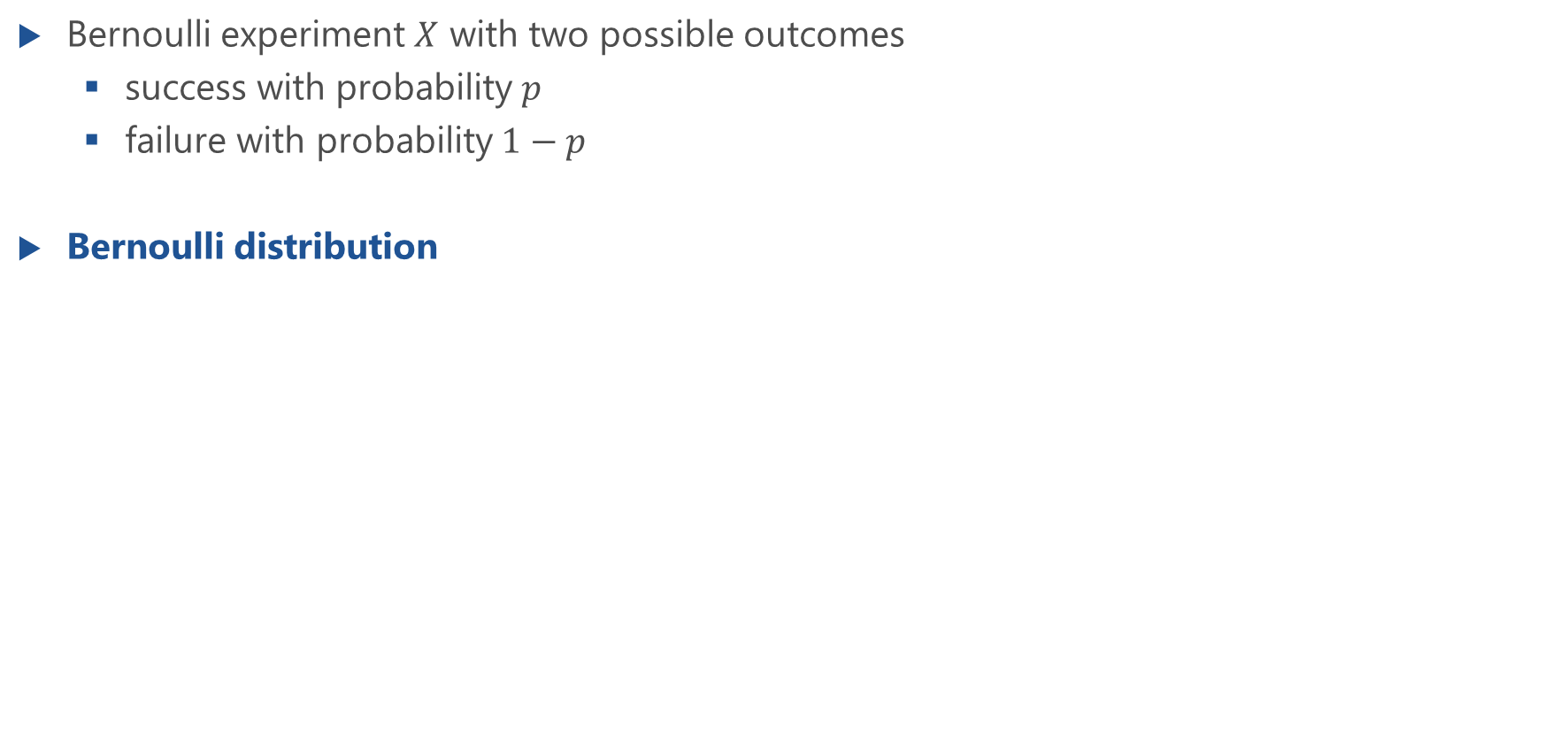
Bernoulli Experiment and Distribution (BER)
Bernoulli experiment $X$ with two possible outcomes
success with probability $p$
failure with probability $1−p$
Bernoulli distribution

Slide 6
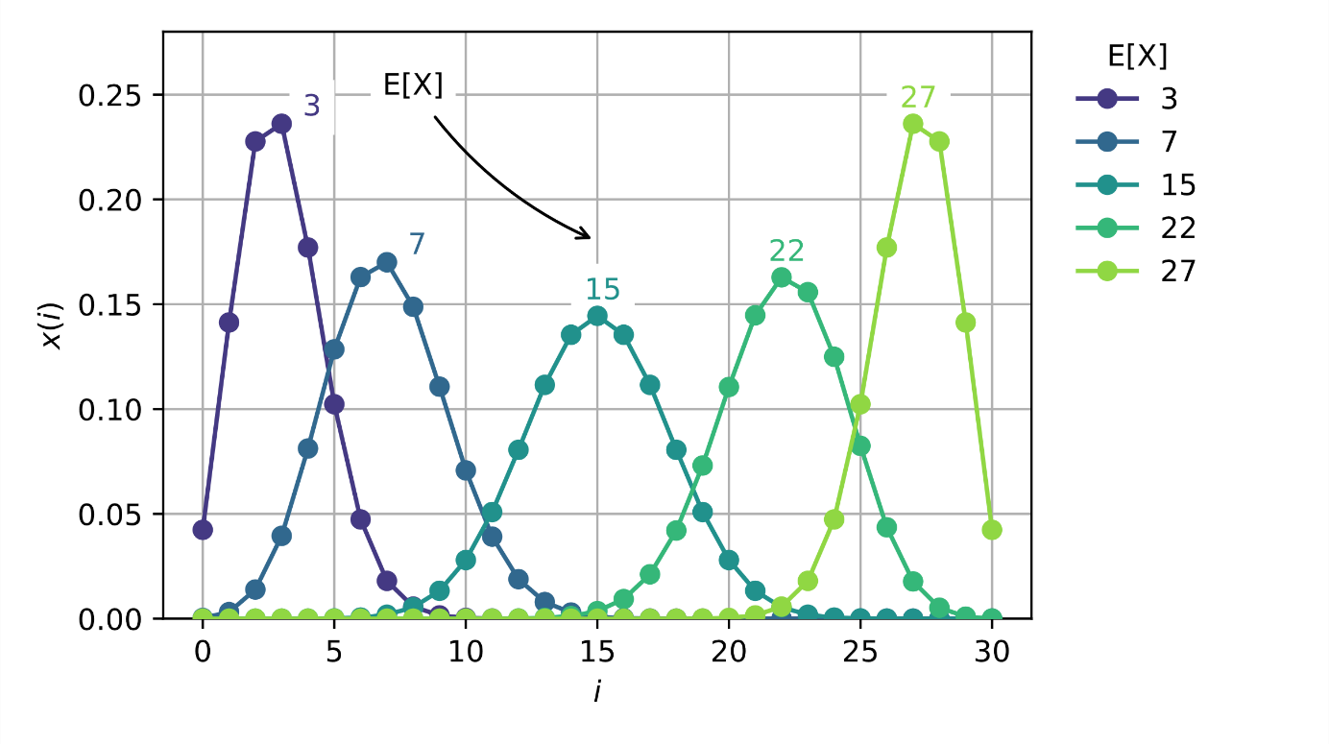
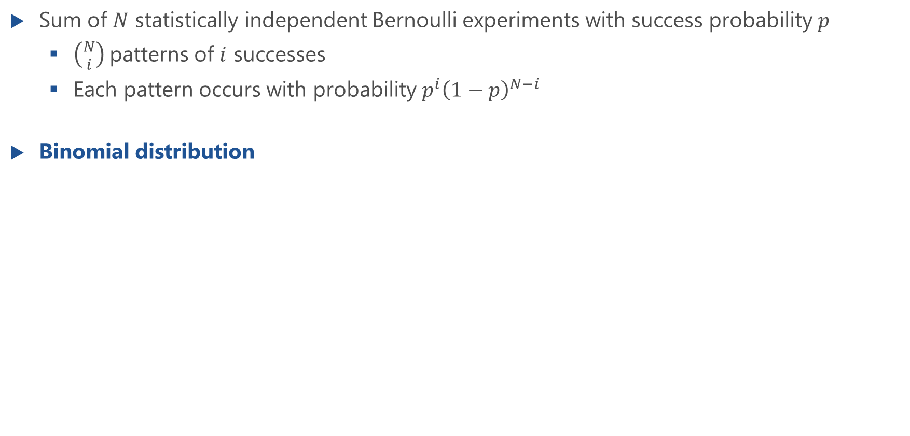
Binomial Distribution (BINOM)
Sum of $N$ statistically independent Bernoulli experiments with success probability $p$
$\left({N \atop i}\right)$patterns of $i$ successes
Each pattern occurs with probability $p^{i}{\left(1−p\right)}^{N−i}$
Binomial distribution

Slide 7
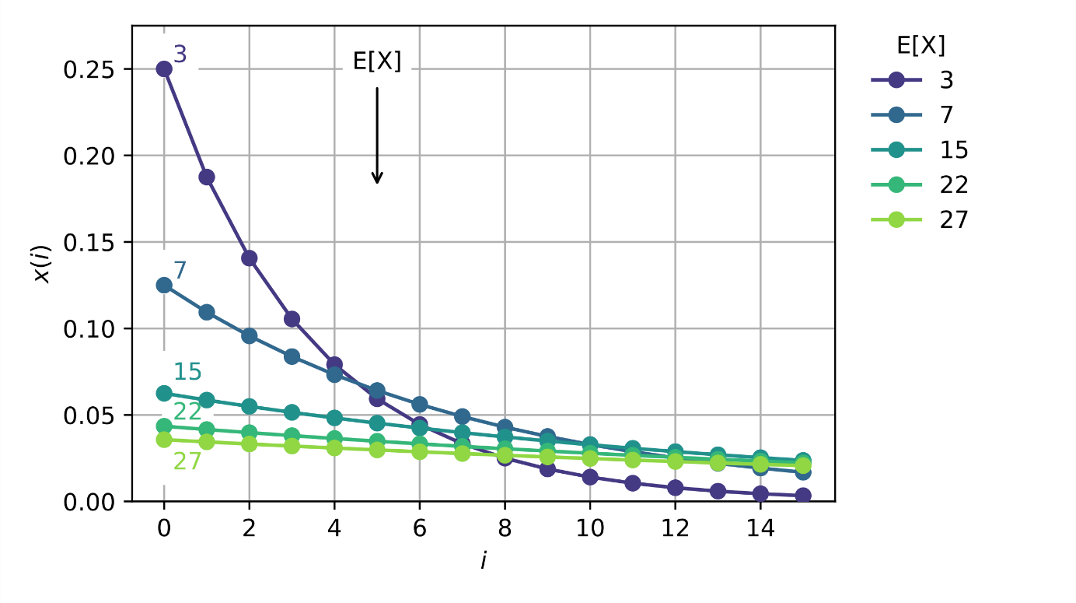
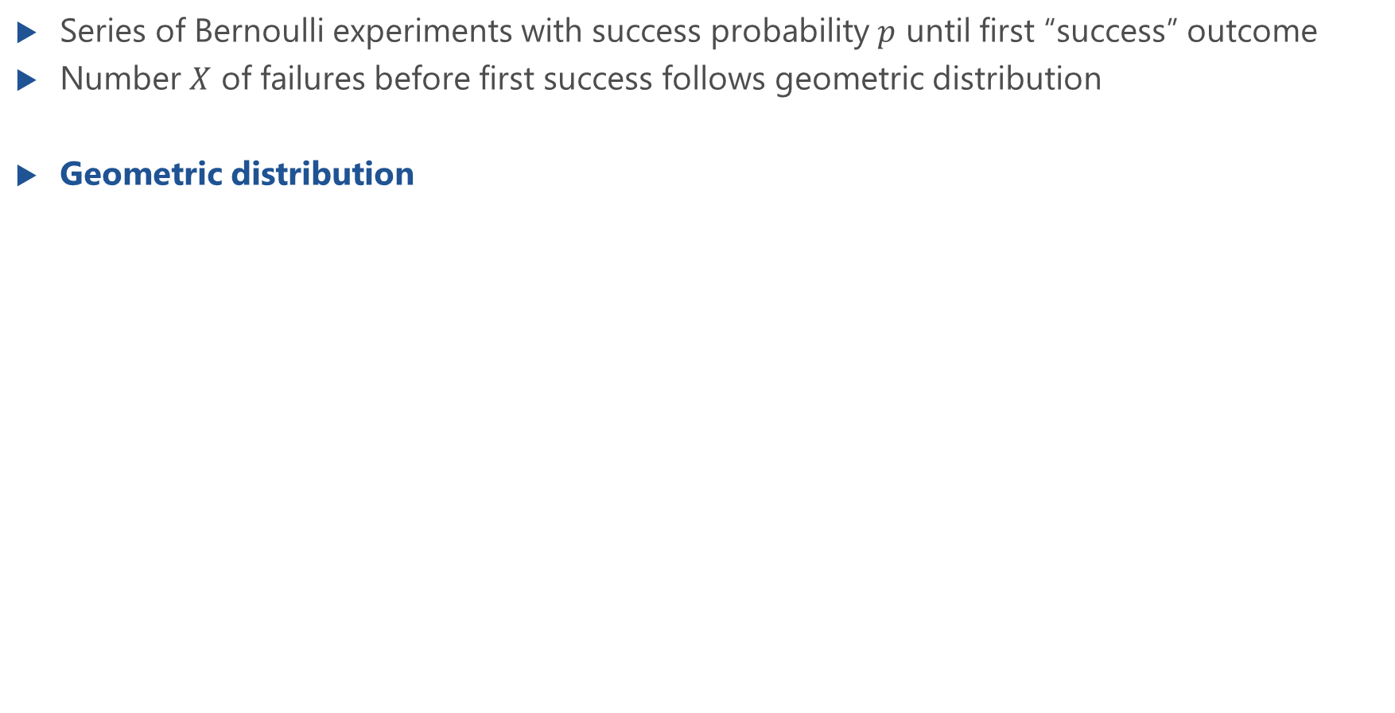
Geometric Distribution (GEOM)
Series of Bernoulli experiments with success probability $p$ until first “success” outcome
Number $X$ of failures before first success follows geometric distribution
Geometric distribution

Slide 8
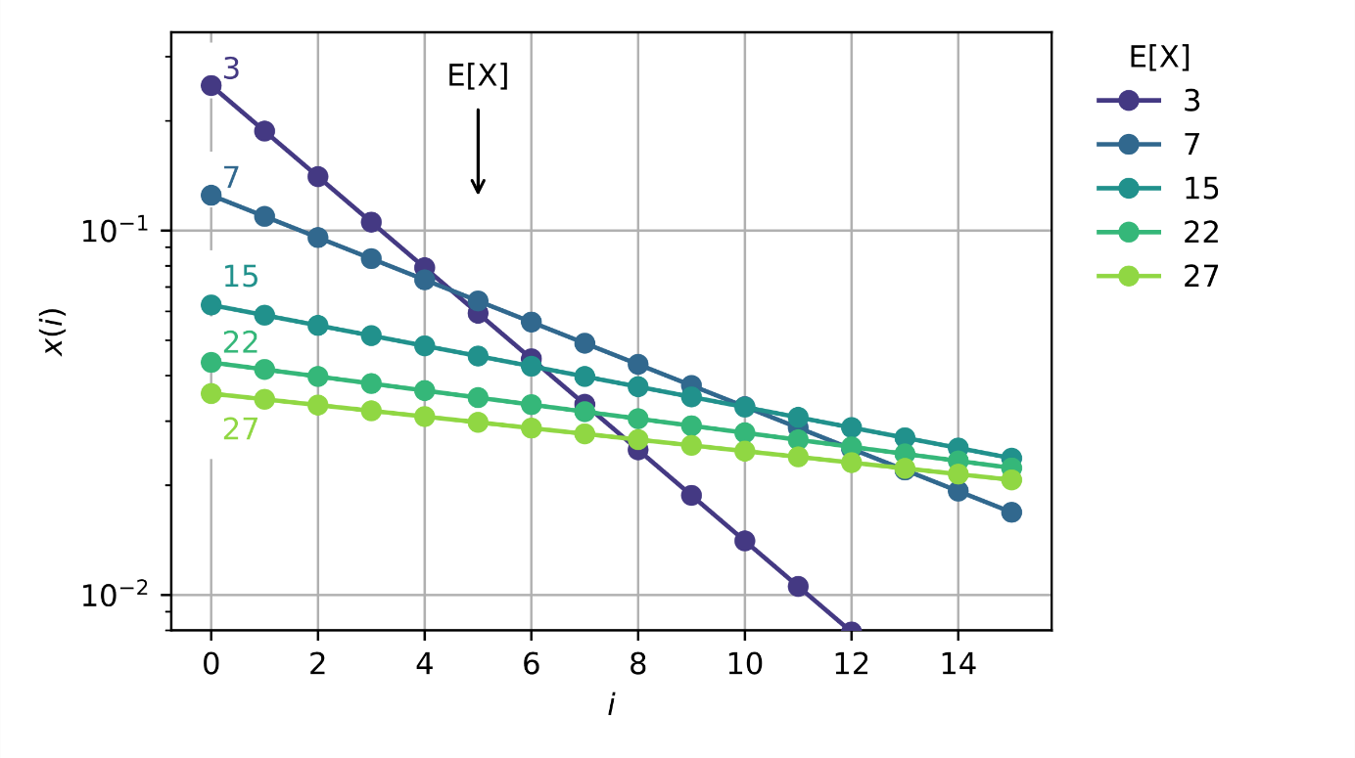
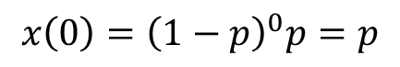
Geometric Distribution: Logarithmic Scale
$$x\left(0\right)={\left(1−p\right)}^{0}p=p$$

Slide 9
Variants of the Geometric Distribution
Lecture

Slide 10
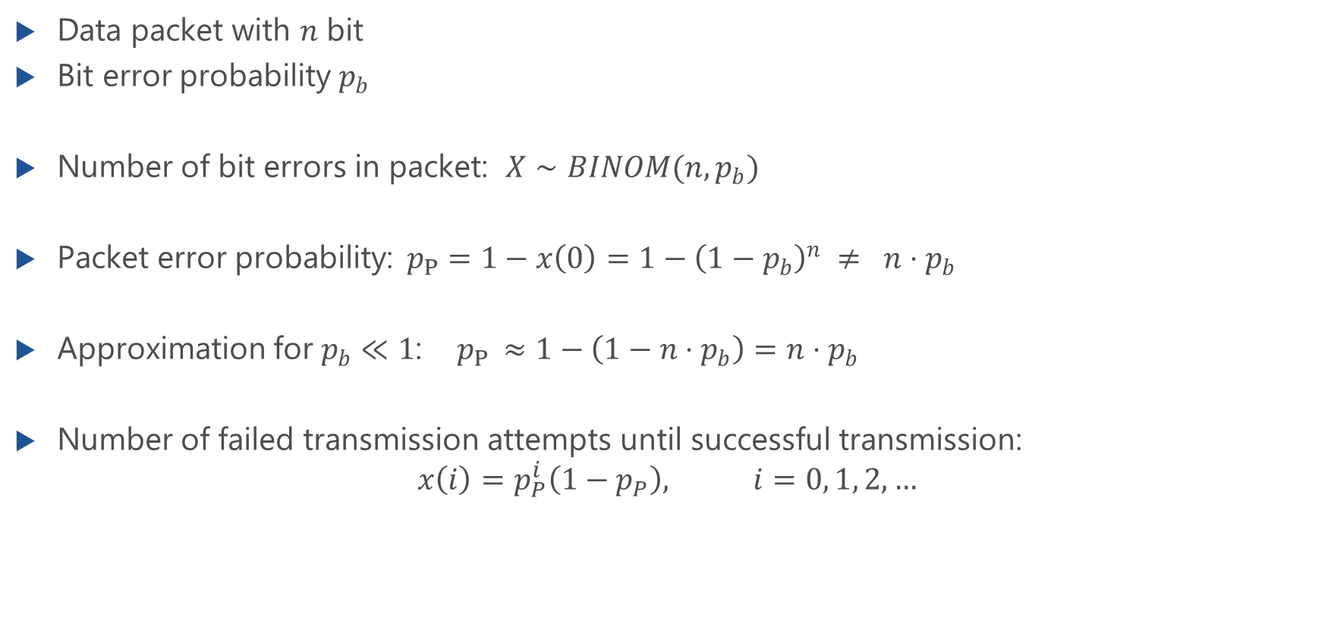
Example: Bit Errors and Packet Errors
Data packet with 𝑛 bit
Bit error probability $p_{b}$
Number of bit errors in packet: $X∼BINOM(n,p_{b})$
Packet error probability: $p_{P}=1−x\left(0\right)=1−{\left(1−p_{b}\right)}^{n} ≠ n⋅p_{b}$
Approximation for $p_{b}≪1$: $p_{P }≈1−\left(1−n⋅p_{b}\right)=n⋅p_{b}$
Number of failed transmission attempts until successful transmission: $x\left(i\right)=p_{P}^{i}\left(1−p_{P}\right), i=0, 1, 2,…$

Slide 11
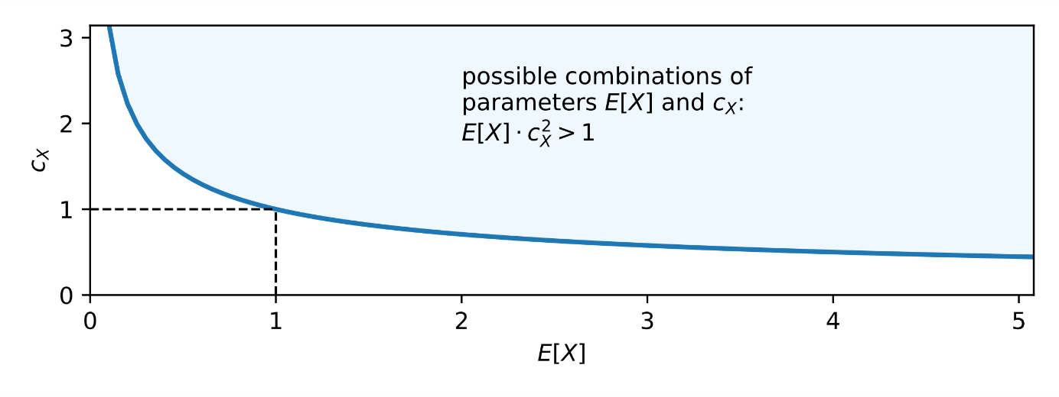
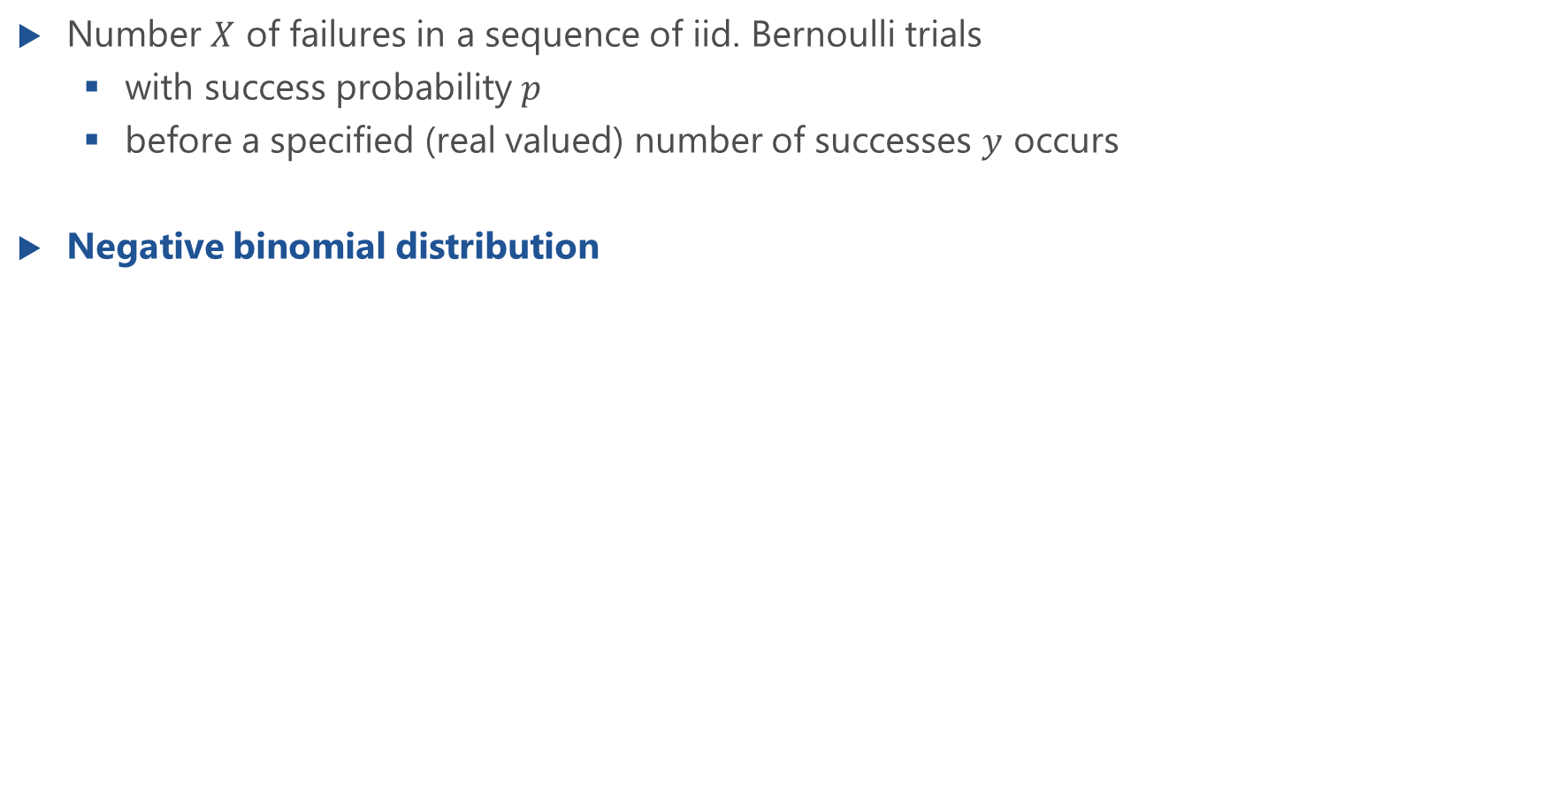
Negative Binomial Distribution (NEGBIN)
Number $X$ of failures in a sequence of iid. Bernoulli trials
with success probability $p$
before a specified (real valued) number of successes $y$ occurs
Negative binomial distribution
For given mean and coefficient of variation

Slide 12
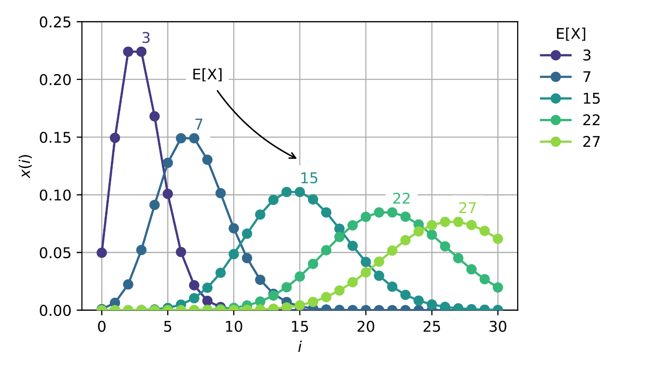
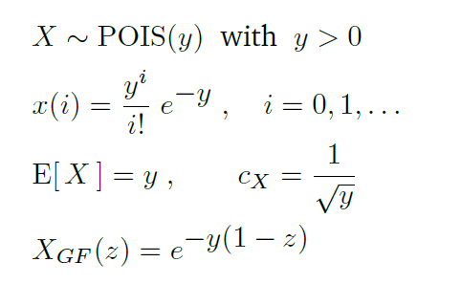
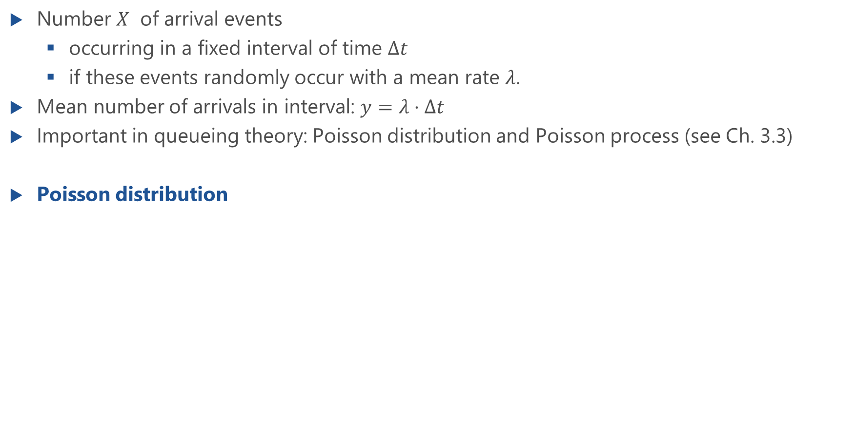
Poisson Distribution (POIS)
Number $X$ of arrival events
occurring in a fixed interval of time $Δt$
if these events randomly occur with a mean rate $λ$.
Mean number of arrivals in interval: $y=λ⋅Δt$
Important in queueing theory: Poisson distribution and Poisson process (see Ch. 3.3)
Poisson distribution

Slide 13
Poisson Distribution and Poisson Process
Lecture

Slide 14
Continuous Distributions
PDF, CDF, Laplace transform

Slide 15
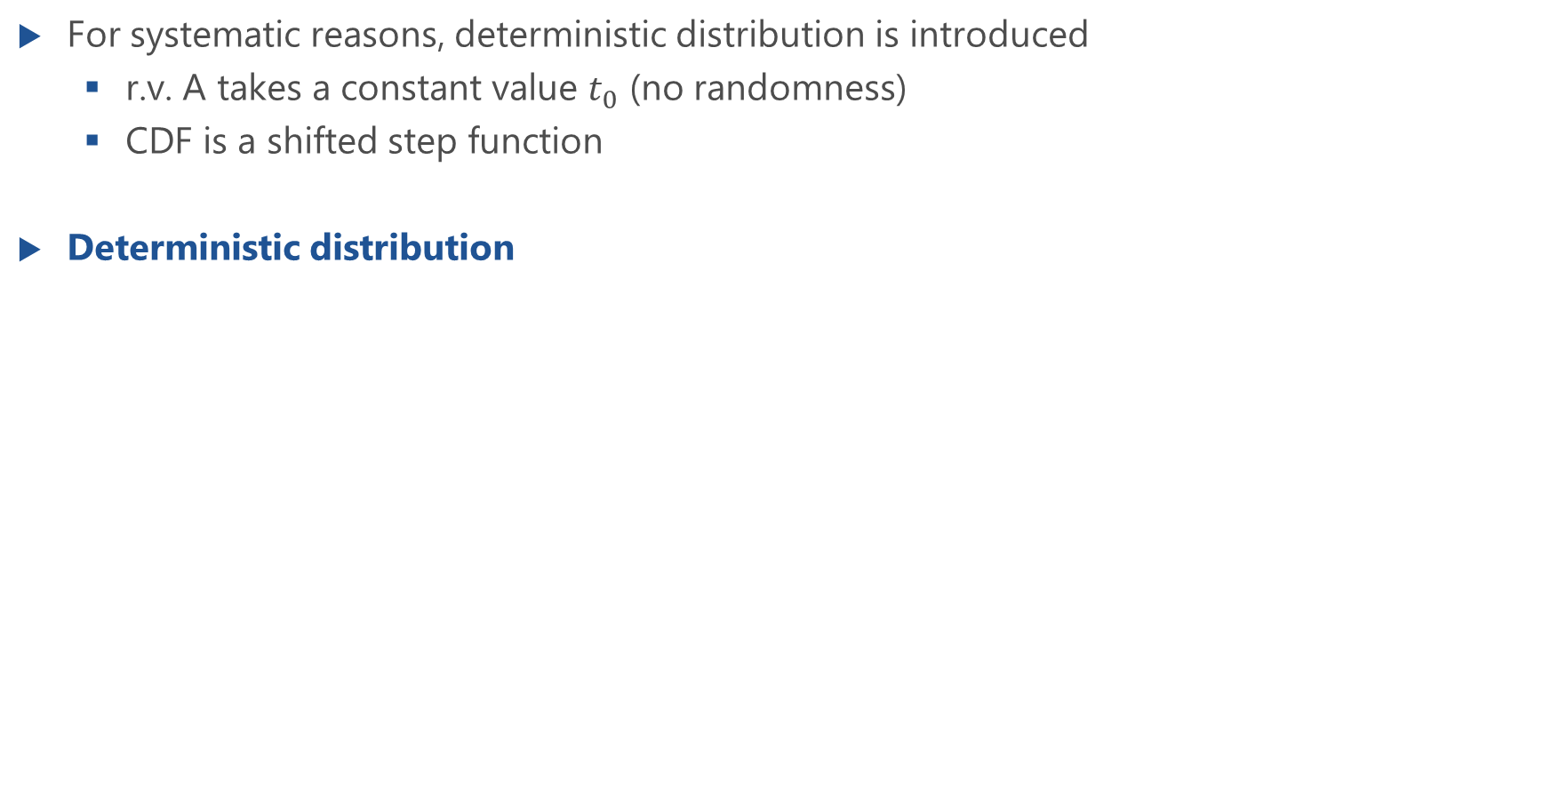
Deterministic Distribution (D)
For systematic reasons, deterministic distribution is introduced
r.v. A takes a constant value $t_{0}$ (no randomness)
CDF is a shifted step function
Deterministic distribution

Slide 16
Deterministic Distribution (D): CDF and PDF
Lecture

Slide 17
Dirac Delta Function
Lecture

Slide 18
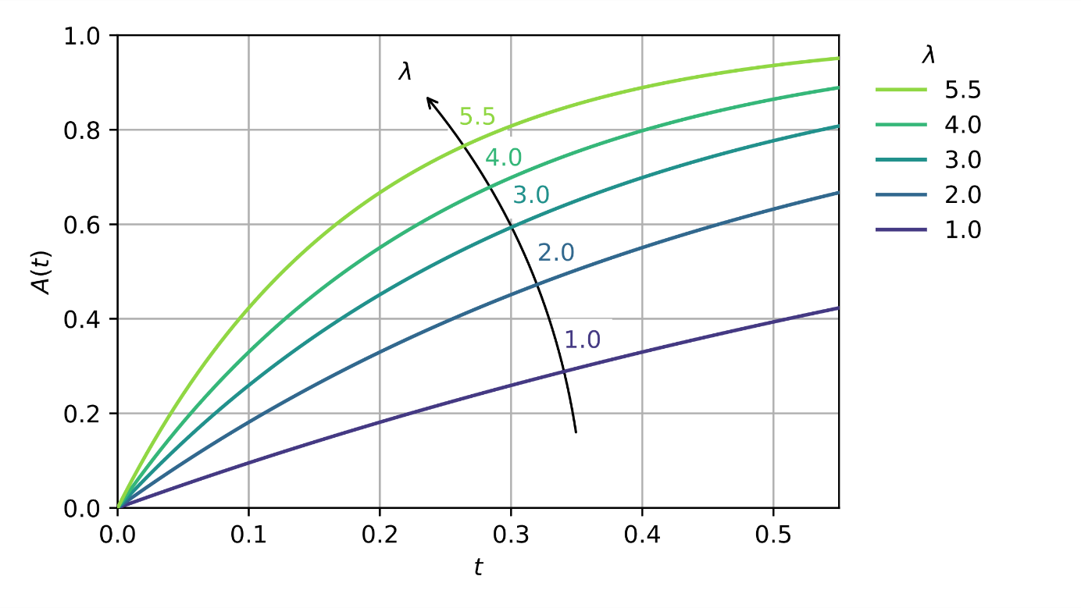
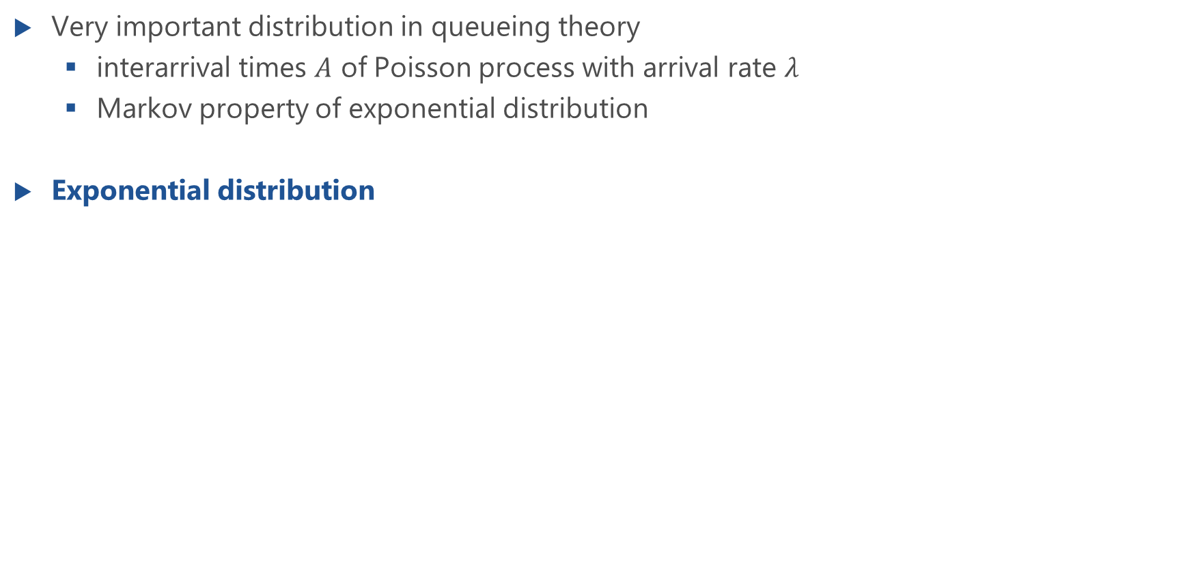
Negative Exponential Distribution (EXP)
Very important distribution in queueing theory
interarrival times $A$ of Poisson process with arrival rate $λ$
Markov property of exponential distribution
Exponential distribution

Slide 19
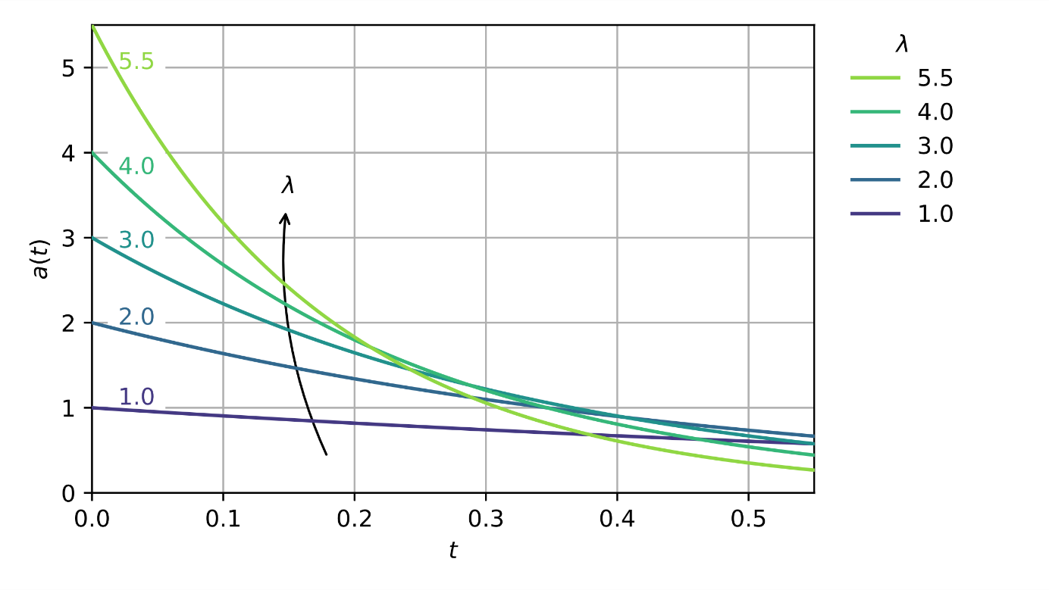
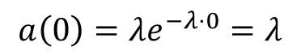
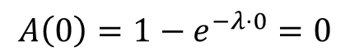
Exponential Distribution: PDF and CDF
$$A\left(0\right)=1−e^{−λ⋅0}=0$$
$$a\left(0\right)=λe^{−λ⋅0}=λ$$

Slide 20
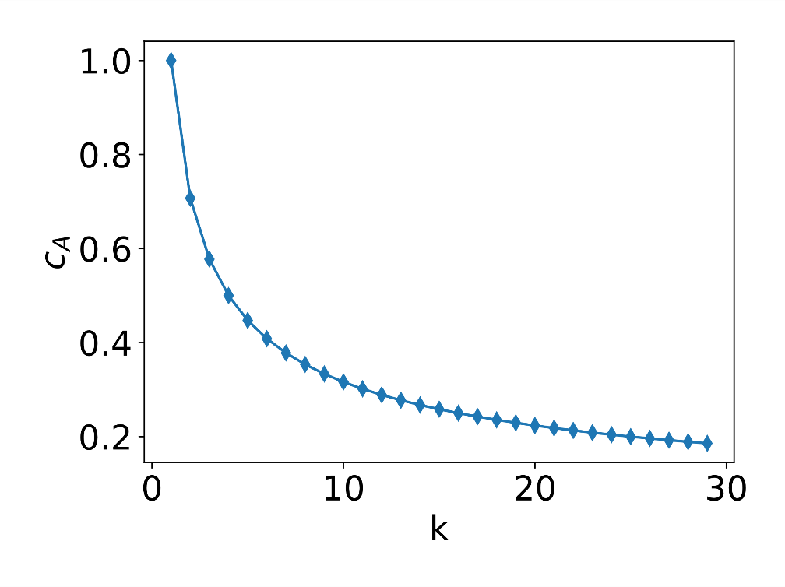
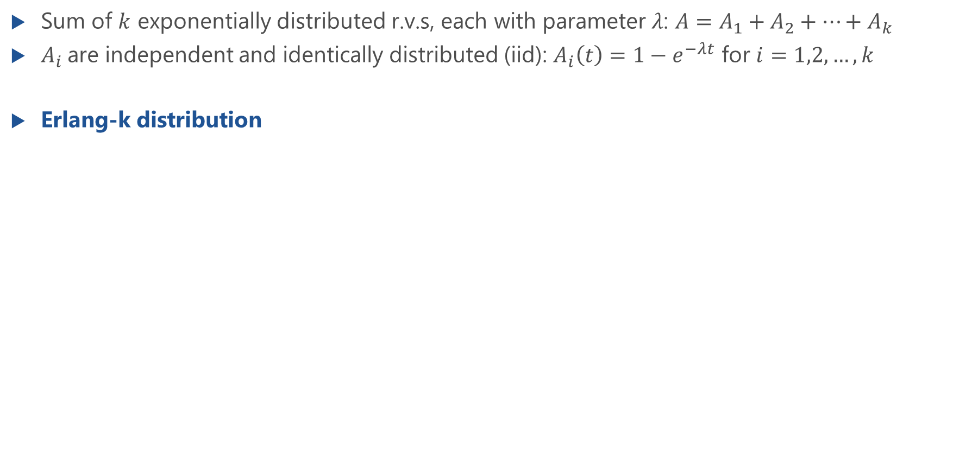
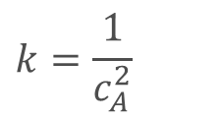
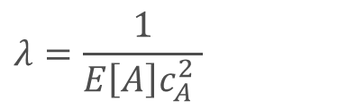

Erlang-k Distribution (E_{k})
Sum of $k$ exponentially distributed r.v.s, each with parameter $λ$: $A=A_{1}+A_{2}+…+A_{k}$
$A_{i}$are independent and identically distributed (iid): $A_{i}\left(t\right)=1−e^{−λt}$ for $i=1,2,…,k$
Erlang-k distribution
For given mean $E[A]$ and coefficient of variation $0<c_{A}≤1$:
$$k=\frac{1}{c_{A}^{2}}$$
$$λ=\frac{1}{E\left[A\right]c_{A}^{2} }$$

Slide 21
Laplace Transform of Erlang-k Distribution
Lecture

Slide 22
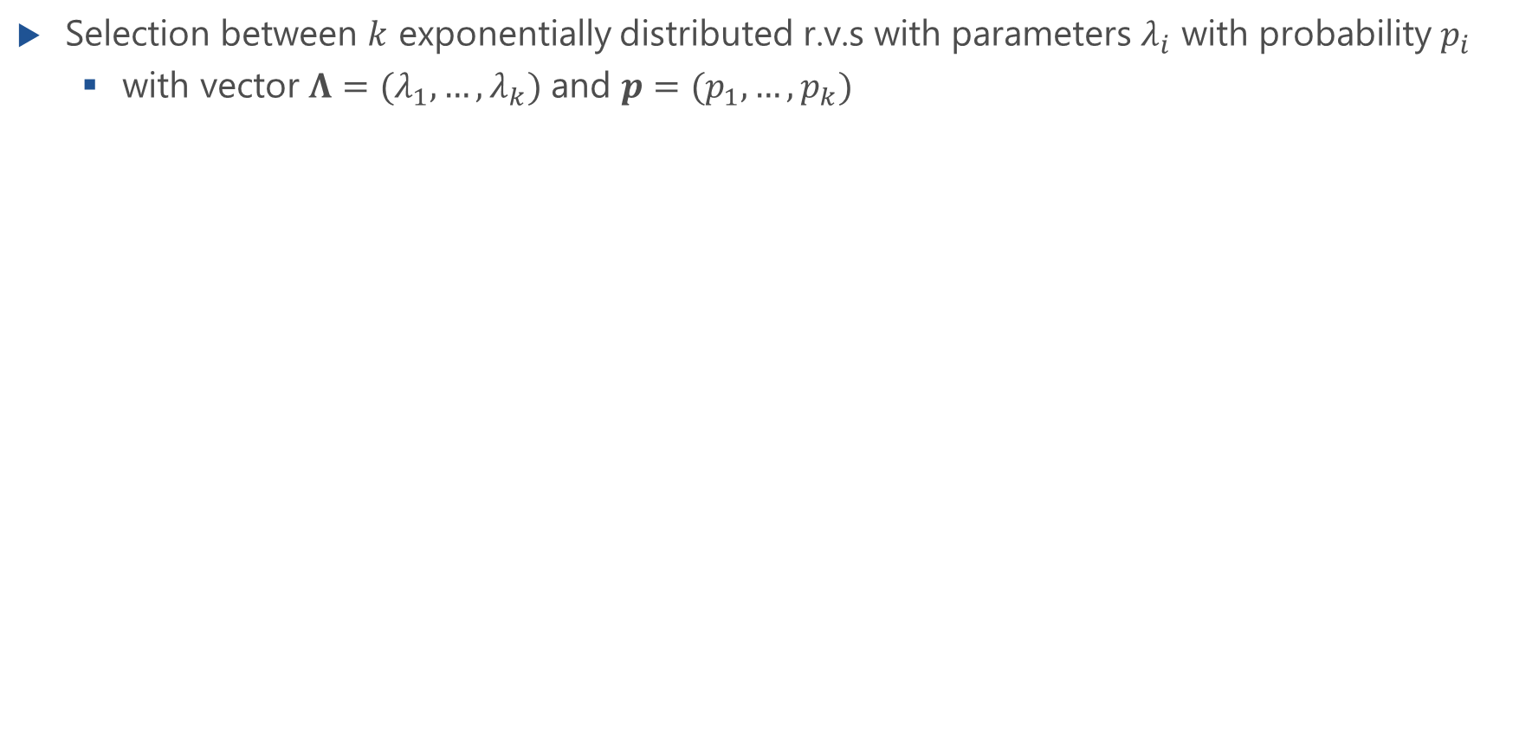
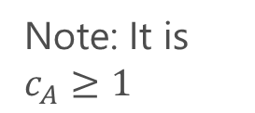
Hyperexponential Distribution (H_{k})
Selection between $k$ exponentially distributed r.v.s with parameters $λ_{i}$ with probability $p_{i}$
with vector $Λ=(λ_{1},…,λ_{k})$ and $p=(p_{1},…,p_{k})$
Note: It is $c_{A}≥1$

Slide 23
Hyperexponential Distribution of Second Order (H₂)
Lecture

Slide 24
Substitute Distributions
Lecture

Slide 25
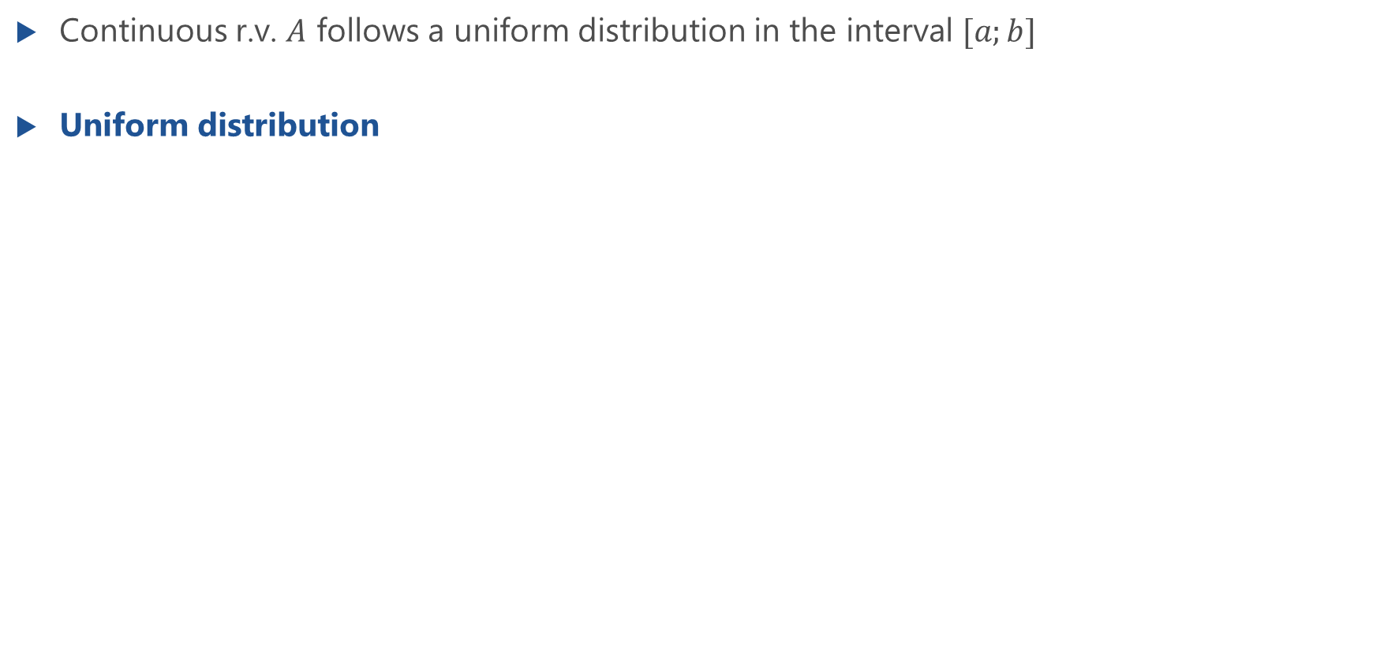
Uniform Distribution (U)
Continuous r.v. $A$ follows a uniform distribution in the interval $[a;b]$
Uniform distribution

Slide 26
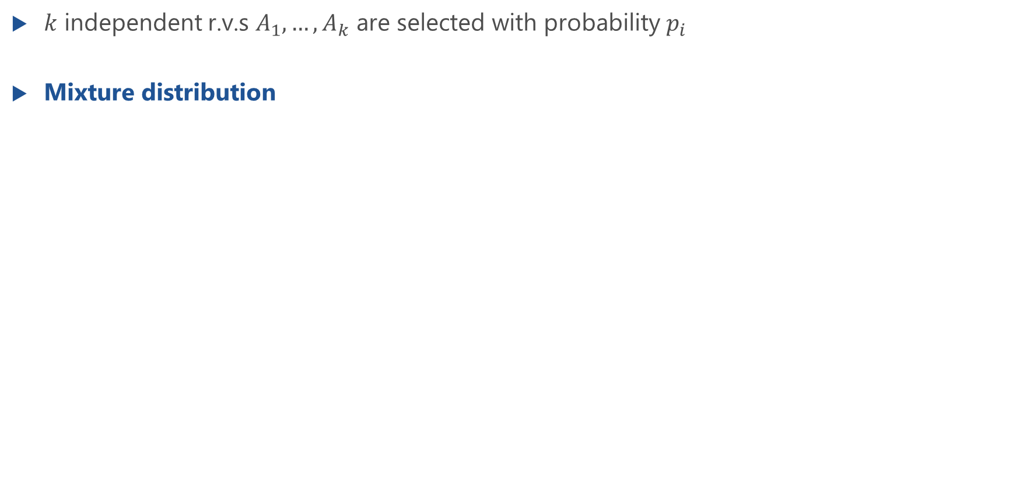
Mixture Distribution (MIX)
$k$ independent r.v.s $A_{1},…,A_{k}$ are selected with probability $p_{i}$
Mixture distribution

Slide 27
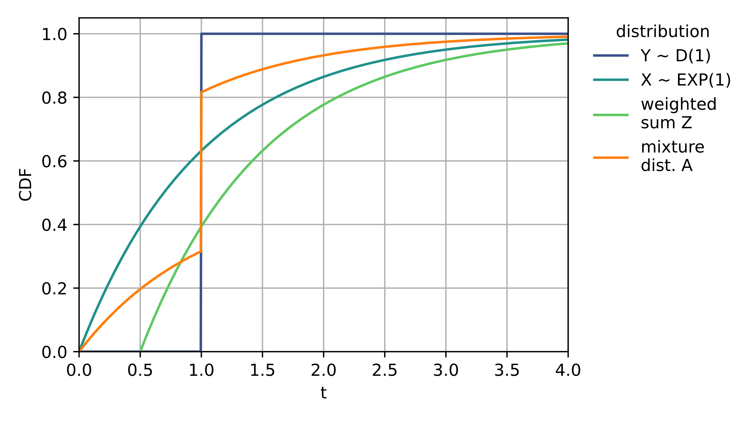
Mixture Distribution: Visualization

Slide 28
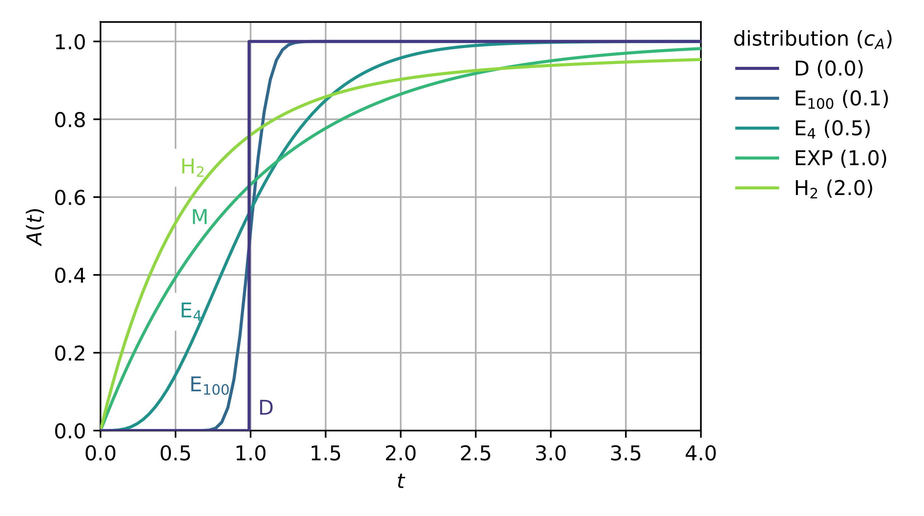
Comparison of Relevant Continuous Distributions

Slide 29
Import Relationships

Slide 30
Continuous Distributions
Phase representation
visual representation of common distributions
indicates relationship of composed distributions

Slide 31
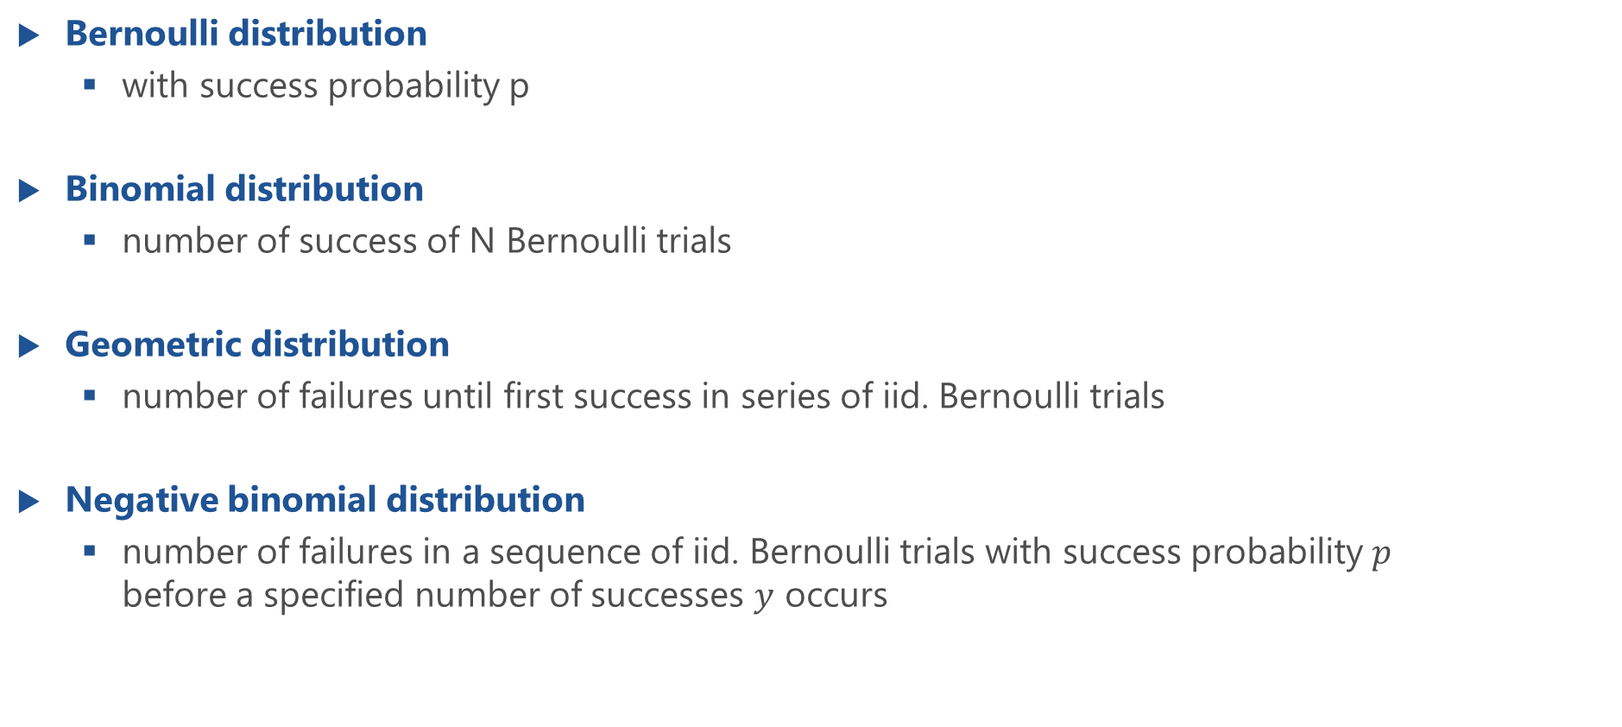
Discrete Distributions
Bernoulli distribution
with success probability p
Binomial distribution
number of success of N Bernoulli trials
Geometric distribution
number of failures until first success in series of iid. Bernoulli trials
Negative binomial distribution
number of failures in a sequence of iid. Bernoulli trials with success probability $p$ before a specified number of successes $y$ occurs

Slide 32
Poisson Arrivals during fixed Interval
Number of Poisson arrivals during fixed interval follows Poisson distribution
Interarrival times follow exponential distribution: Poisson process

